Slide 1
Jetstream Devs Proposal : Streamline Documents to improve operations
04 Aug 2025

Slide 2
Background for Proposed Project
Objective: To streamline operational efficiency by consolidating fragmented domain-level documentations into a centralized, intelligent HTML-based system.
Description: Support/Delivery teams currently maintain siloed documents for Application Information, Root Cause Analysis (RCA), Known Error Databases (KEDB), troubleshooting procedures, and operational guidelines. This fragmentation leads to delays in issue resolution, inconsistent knowledge sharing, and increased support workload.
The proposed solution is to extract all the relevant information from all available documents and merge all relevant information into a single HTML-based platform with below benefits:
Key Benefits:
Unified Format: A merged document ensures consistency in formatting, terminology, and structure, which helps teams collaborate more effectively.
Centralized Information: Merging documents creates a single source of truth, making it easier for teams to find relevant information quickly.
Reduced Duplication: Eliminates redundant content across multiple documents, streamlining updates and maintenance.
Comprehensive Support & Quicker Issue Resolution : A single document can cover a wider range of scenarios, reducing the need for follow-up queries.
Scalability: As services or products evolve, a merged document can be expanded more easily than multiple fragmented ones.
Eliminate duplicate/conflicting documents
Future Potential: The demand for intelligent knowledge management systems is growing rapidly across industries. With increasing complexity in IT infrastructure, support operations, and DevOps environments, organizations are seeking ways to reduce downtime, accelerate issue resolution, and improve cross-functional collaboration.

Slide 3
Logical Workflow
Document Uploader
Parse into readable format
AI processing : Extract Relevant information
Extract into HTML Format
Store Documents in HTML
Submit another document

Slide 4
Implementation Phase
Phases of Implementation: Implementation is straightforward and incremental:
Phase 1: Document Consolidation
Merge existing RCA, KEDB, and procedures into a standardized format.
Minimal disruption, leveraging current team expertise.
Phase 2: HTML-Based Portal Development
Use lightweight web technologies to create the portal interface.
Internal web development or DevOps teams can execute with low external dependency.
Phase 3: AI Feature Integration
Integrate contextual search, smart suggestions, and keyword tagging using readily available AI services (e.g., OpenAI, Amazon Kendra).
Phase 4: Rollout and Training
Gradual onboarding across teams.
Reusable Framework: The platform is built with reusability which enabling:
Cross-project and cross-team deployment with minimal customization—only the underlying documents and branding may vary.
Reusable templates and components for consistent documentation structure and faster onboarding of new content areas.
Codebase reusability for future internal tools, dashboards, or knowledge repositories using the same framework.

Slide 5
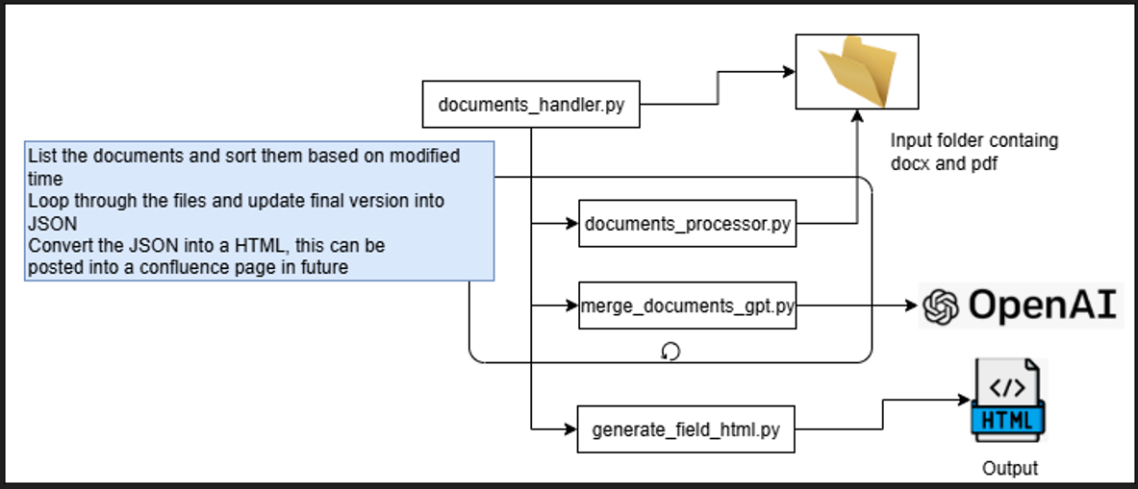
Technical Plan : Workflow

Slide 6
Thank you

